Slide 1
Ch - 4
Link-List

Slide 2
List Overview
Linked lists
Abstract data type (ADT)
Basic operations of linked lists
Insert, find, delete, print, etc.
Variations of linked lists
Circular linked lists
Doubly linked lists
Use of both Method :
(LIFO –FIFO)

Slide 3
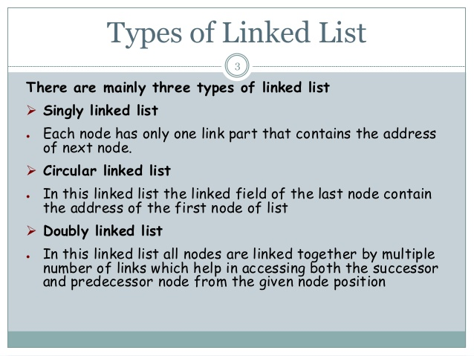

Slide 4
Linked Lists
A
B
C
∅
Head
A linked list is a series of connected nodes.
Each node contains at least
A piece of data (any type)
Pointer to the next node in the list
Head: pointer to the first node
The last node points to NULL
node
A
data
pointer

Slide 5
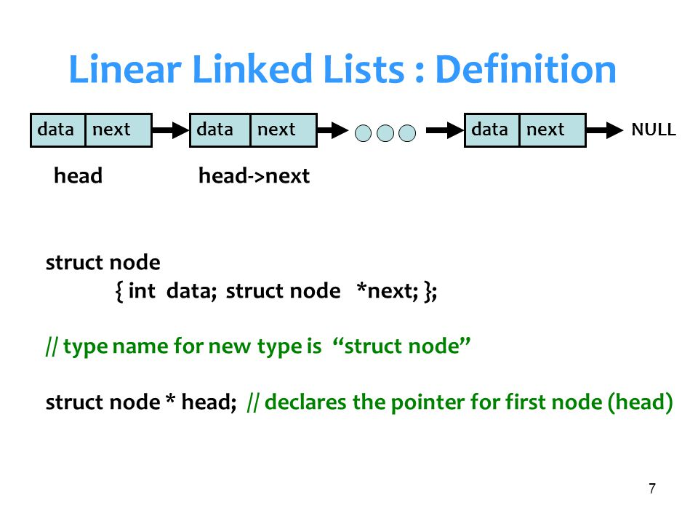

Slide 6
A Simple Linked List Class
Operations of List
IsEmpty: determine whether or not the list is empty.
InsertNode: insert a new node at a particular position.
FindNode: find a node with a given value.
DeleteNode: delete a node with a given value.
DisplayList: print all the nodes in the list

Slide 7
Inserting a new node
Possible cases of InsertNode
Insert into an empty list
Insert in front
Insert at back
But, in fact, only need to handle two cases
Insert as the first node (Case 1)
Insert in the end of the list (Case 2)

Slide 8
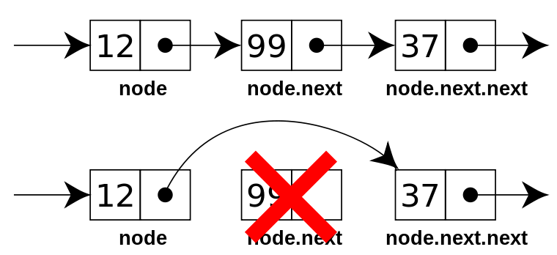
Delete node
Possible cases of DeleteNode
Delete into an empty list
Delete in front
Delete at back
But, in fact, only need to handle two cases
Delete as the first node (Case 4)
Delete in the end of the list (Case 5)

Slide 9
